Slide 1



BIG DATA ANALYTICS
UNDER THE GUIDANCE OF
MR.A.KRISHNA
(ASSISTANT PROFESSOR)
TEAM
AMOGH PITTI (LEAD) – 21WJ1A6905
A.SAMEEKSHA REDDY – 21WJ1A6901
KONDAPARTHY THARUN – 21WJ1A6935

Slide 2

PROJECT TITLE
Snowflake for Healthcare Analytics - Leveraging Clinical and Patient Data for Insights and Decision Making
TABLE OF CONTENTS
Abstract
Introduction
Existing System
Proposed System
Literature Survey
Methodology
Challenges & Solutions
System Architecture
Conclusion

Slide 3

ABSTRACT
Healthcare Potential: The effective use of clinical and patient data can improve patient outcomes, optimize healthcare services, and support evidence-based decision-making.
Snowflake Platform:
A cloud-based platform known for scalability, performance, and accessibility.
Provides a secure, centralized system for storing and analyzing diverse healthcare data.
Key Benefits:
Helps healthcare providers access actionable insights.
Supports strategic, data-driven decisions.
Enhances the overall quality of healthcare delivery.
Project Focus: This project explores how Snowflake can be utilized to analyze clinical and patient data, enabling informed decisions that improve healthcare outcomes.

Slide 4
INTRODUCTION
The Role of Data in Healthcare:
Leveraging data is essential for improving patient outcomes and enhancing care delivery.
Current Challenge:
The rapid growth of clinical and patient data makes it difficult to manage, analyze, and extract actionable insights.
Introducing Snowflake as a Solution:
Snowflake provides a scalable, secure, and centralized cloud platform tailored for healthcare analytics.
Offers an efficient way to store, manage, and analyze diverse healthcare data.
Project Goal:
This project explores how Snowflake can transform raw healthcare data into valuable insights.
Supports evidence-based decisions, ultimately improving patient care and operational efficiency.

Slide 5
EXISTING SYSTEM
Challenges in Data Management:
Managing clinical and patient data is increasingly difficult due to data complexity and volume.
Reliance on Traditional Systems:
Many healthcare providers use outdated systems that cannot handle modern data requirements.
Data Fragmentation:
Data is often stored in disconnected platforms, making consolidation and effective analysis challenging.
Limited Real-Time Insights:
Lack of system integration prevents real-time analysis, resulting in missed opportunities for timely, data-driven decisions.
Data Security and Compliance Issues:
Ensuring data security and regulatory compliance adds further complexity to data management.
Impact on Innovation and Efficiency:
These limitations hinder innovation and prevent healthcare organizations from fully improving patient outcomes and operational efficiency.

Slide 6
PROPOSED SYSTEM
Centralized Data Repository: Implement a cloud-based platform (e.g., Snowflake) to consolidate and manage clinical and patient data from various sources.
Real-Time Data Processing: Enable real-time analysis to support timely decision-making and improve patient care.
Advanced Analytics Tools: Integrate machine learning algorithms for predictive analytics and evidence-based clinical decisions.
Enhanced Security and Compliance: Ensure robust security measures and compliance protocols to protect sensitive healthcare data.
User-Friendly Dashboard: Develop an interactive dashboard for healthcare professionals to visualize data insights and monitor key performance indicators.
Training and Support: Provide comprehensive training and ongoing support for healthcare staff to effectively utilize the new system, ensuring they can leverage data insights to improve patient care.

Slide 7
LITERATURE SURVEY
Advancements in Big Data Analytics (2022): The integration of Big Data with AI and IoT has revolutionized healthcare by enhancing decision-making and addressing operational challenges.
Challenges in Data Integration (2022): Fragmented healthcare systems highlight the need for unified platforms to enable effective analytics and comprehensive data analysis.
AI and Machine Learning in Analytics (2023): AI models are increasingly applied to predict patient outcomes, improve diagnostics, and personalize treatments, driving efficiency in healthcare.
Future Trends in Healthcare Analytics (2023): Real-time data processing and predictive analytics are crucial for streamlining operations and solving complex healthcare challenges.

Slide 8
METHODOLOGY
Data Collection: Review literature on healthcare analytics and identify relevant clinical and patient data sources for integration into Snowflake.
System Design: Develop a centralized data architecture in Snowflake, defining schemas for managing both structured and unstructured data.
Analytics Implementation: Integrate machine learning algorithms for data processing and insights, creating workflows for data ingestion and transformation.
Dashboard Development: Create an interactive user-friendly dashboard for healthcare professionals to access and visualize data insights.
Testing and Deployment: Conduct system testing for accuracy and compliance, train staff, and deploy the system while collecting user feedback for ongoing improvement.

Slide 9
CHALLENGES AND SOLUTIONS
Data Fragmentation:
Challenge: Healthcare data is scattered across multiple systems, complicating analysis.
Solution: Use Snowflake to create a centralized repository for seamless data integration and access.
Data Security and Compliance:
Challenge: Protecting sensitive patient information while ensuring regulatory compliance.
Solution: Leverage Snowflake’s security features and establish robust compliance protocols to maintain data integrity.
User Adoption:
Challenge: Resistance to new technologies among staff.
Solution: Provide comprehensive training and ongoing support to enhance user confidence and proficiency.

Slide 10
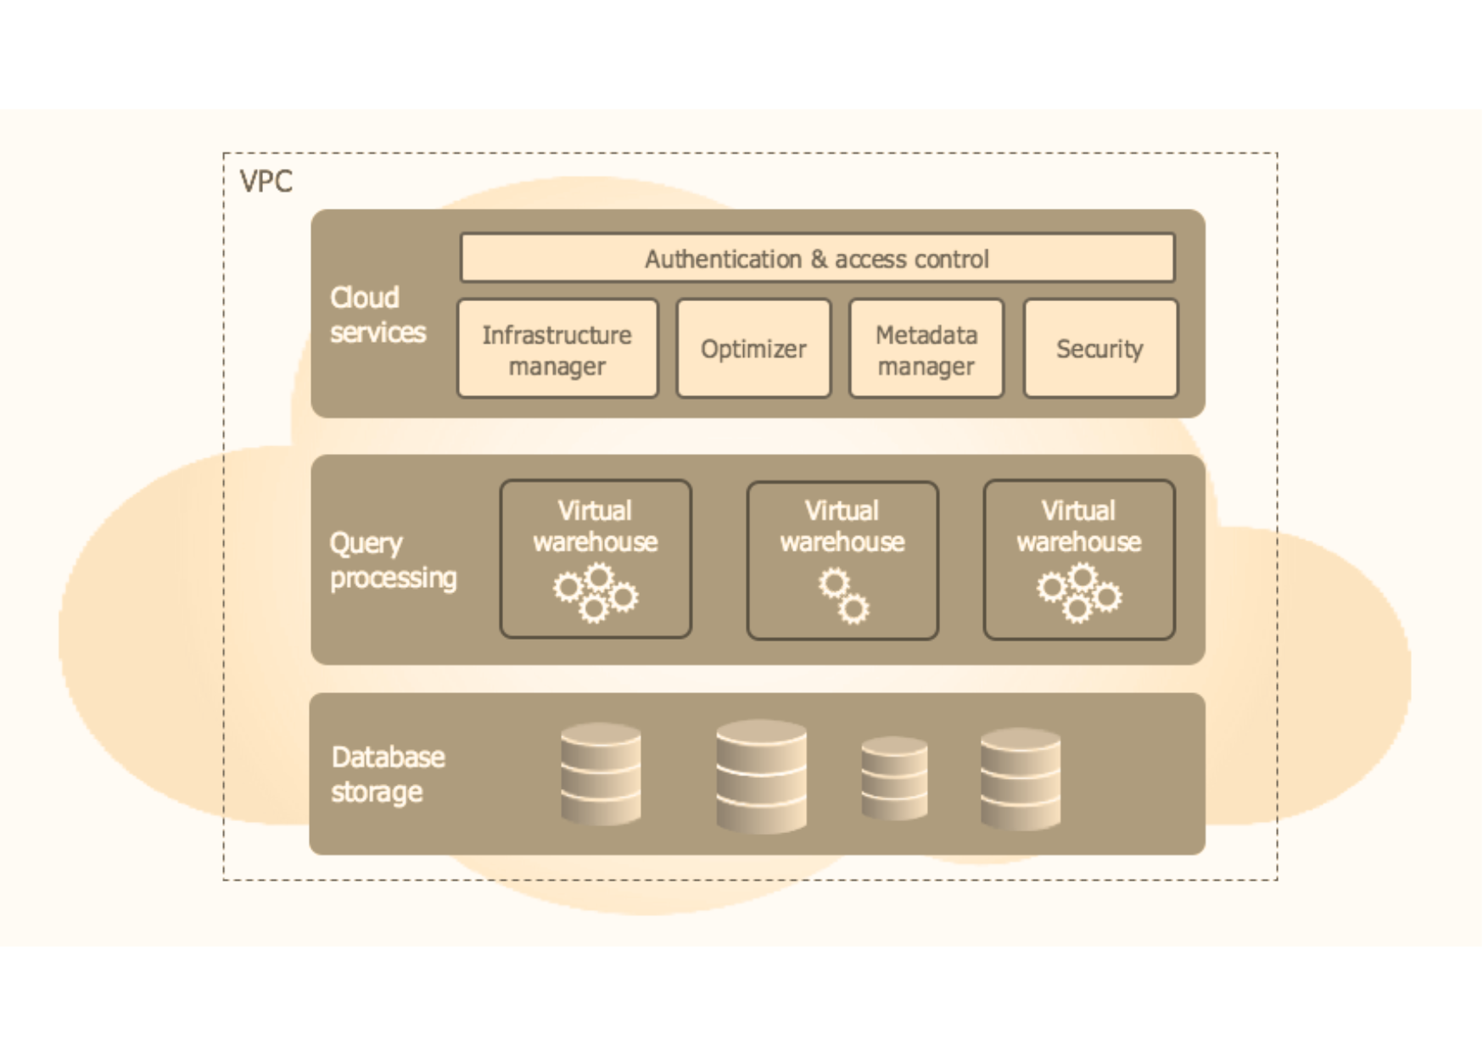
SYSTEM ARCHITECTURE
Cloud Services Layer:- Manages key functions like authentication, access control, metadata management, query optimization, and security. Ensures compliance with healthcare standards like HIPAA, while optimizing query performance.
Database Storage Layer:- Centralized, scalable cloud storage stores patient records, clinical data, and other healthcare datasets. The separation of compute and storage allows for cost-effective, flexible scaling.
Query Processing Layer (Virtual Warehouses):- Virtual warehouses perform data processing independently, enabling efficient execution of real-time analytics, batch processing, and advanced machine learning tasks. Multiple warehouses support isolated workloads for better performance.
Insights Delivery:- Processed data is delivered through dashboards, reports, and AI models, providing actionable insights to healthcare professionals, researchers, and administrators for decision-making and improving patient care.

Slide 11
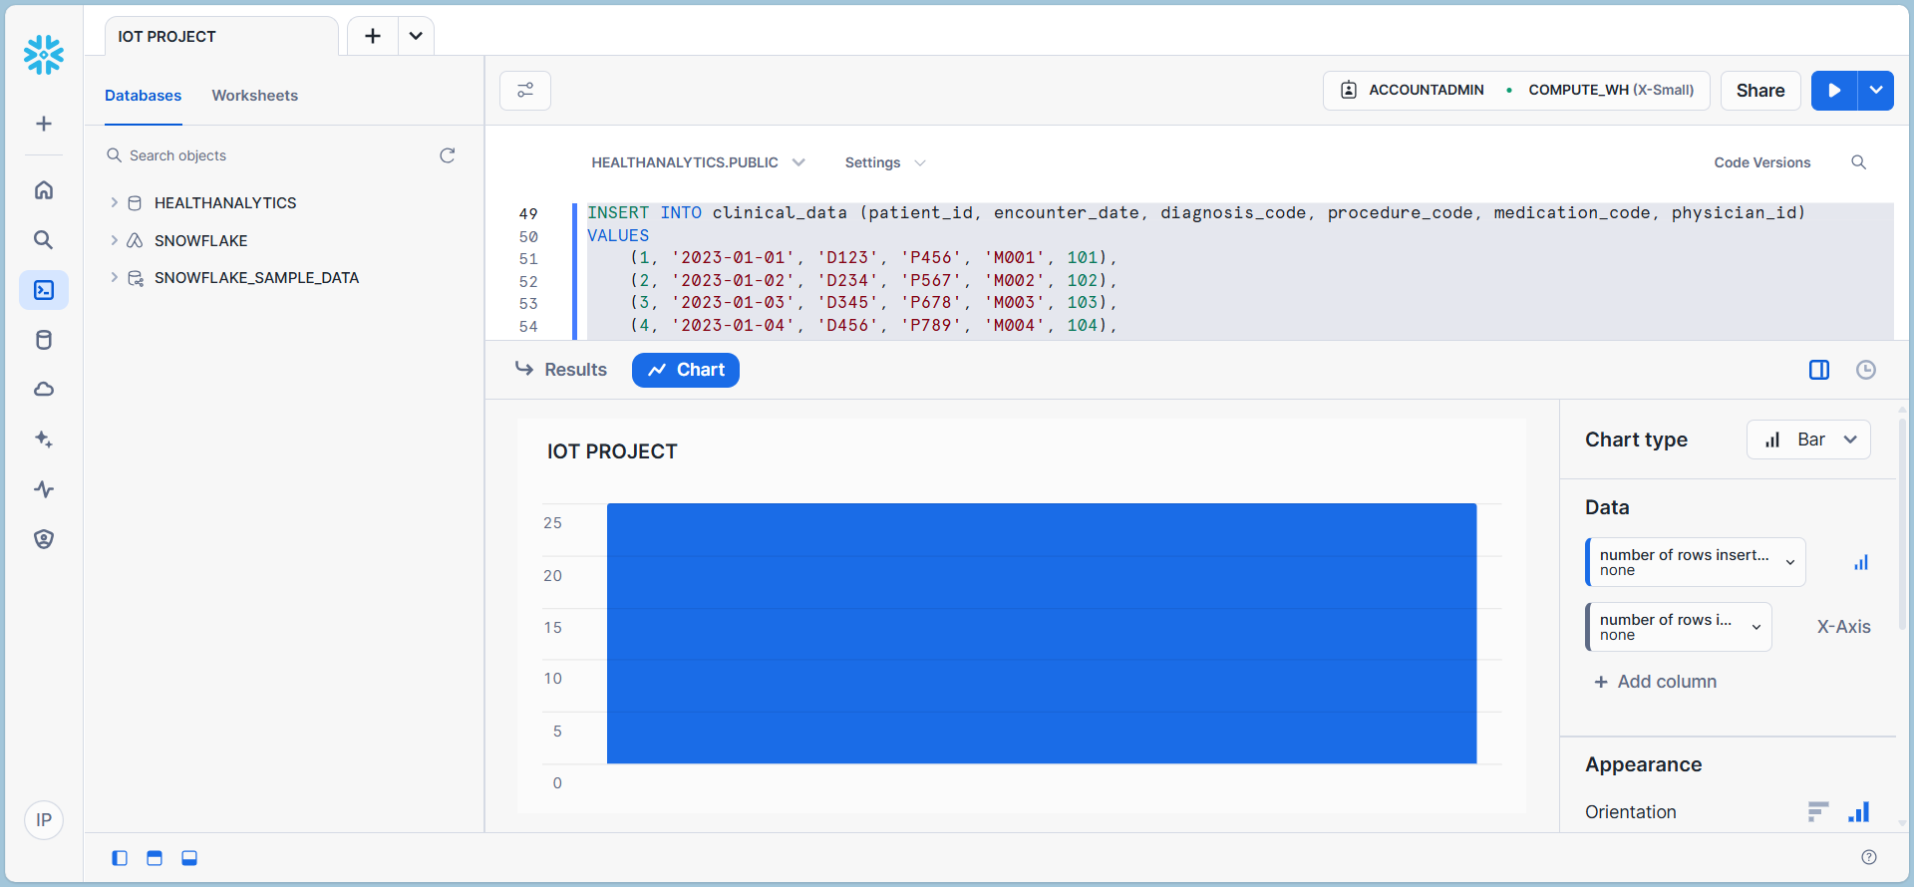
OUTPUT

Slide 12
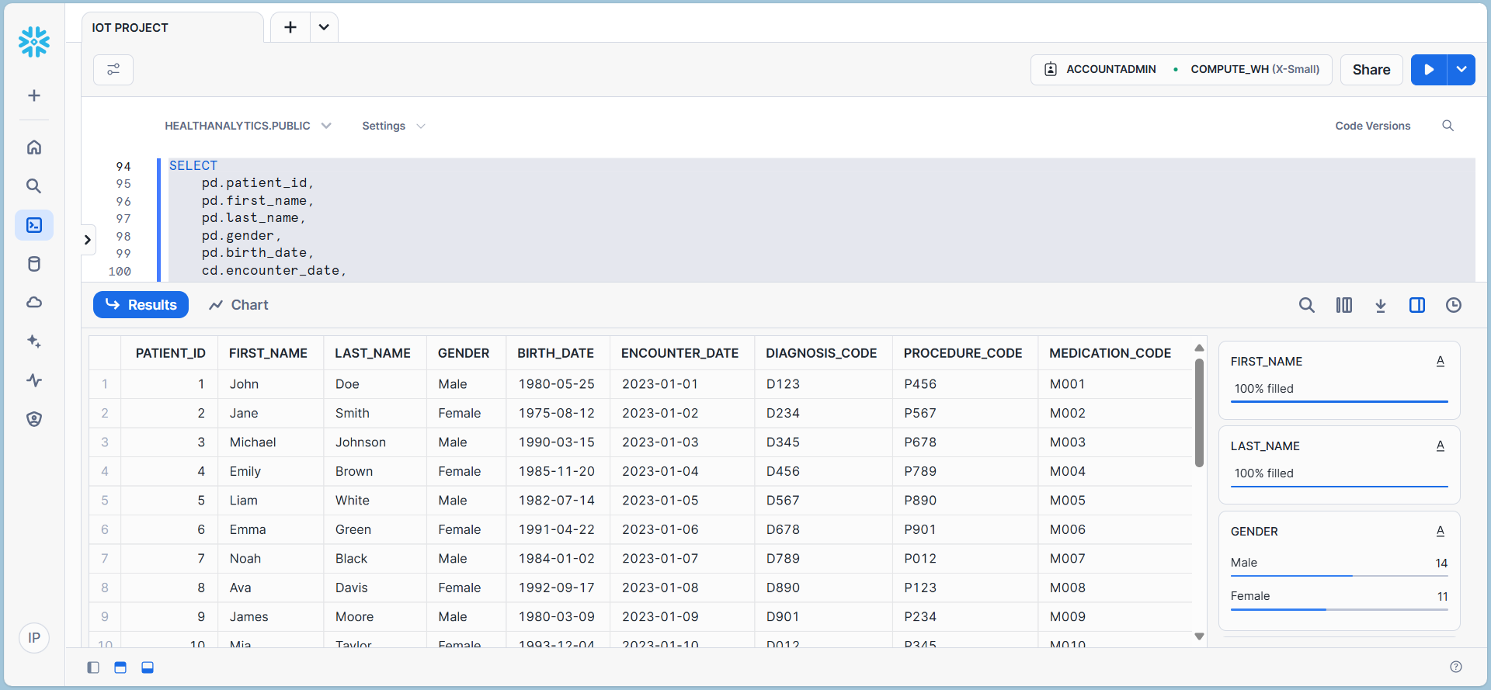
OUTPUT

Slide 13
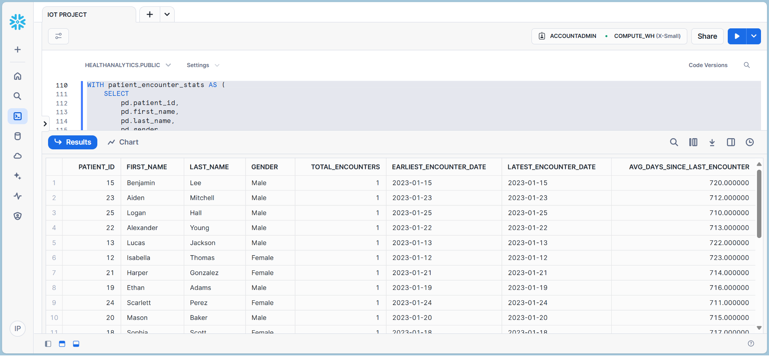
OUTPUT

Slide 14
FUTURE SCOPE
Integration with AI/ML: Snowflake can be enhanced with machine learning and AI tools to provide predictive analytics, automated decision-making, and personalized healthcare recommendations.
Improved Real-Time Insights: Advanced real-time data ingestion and processing can enable quicker decision-making in critical healthcare scenarios.
Enhanced Data Security: Development of advanced encryption techniques and privacy measures to ensure compliance with evolving regulations and protect sensitive patient information.
Scalable Interoperability: Facilitate seamless integration with other healthcare systems and platforms for a unified ecosystem.

Slide 15
CONCLUSION
Project Focus: Demonstrates the potential of using Snowflake for healthcare analytics by centralizing clinical and patient data.
Key Benefits:
Improved data integration, security, and real-time processing.
Enables healthcare providers to make informed, data-driven decisions.
Outcomes:
Enhances patient outcomes.
Boosts operational efficiency in healthcare.
Proposed System:
Ensures scalability and compliance.
Adapts to the growing complexities of modern healthcare data.

Slide 16
THANK YOU

